Slide 1

HTML and CSS Chapter 2: Building a Webpage Template with HTML 5

Slide 2
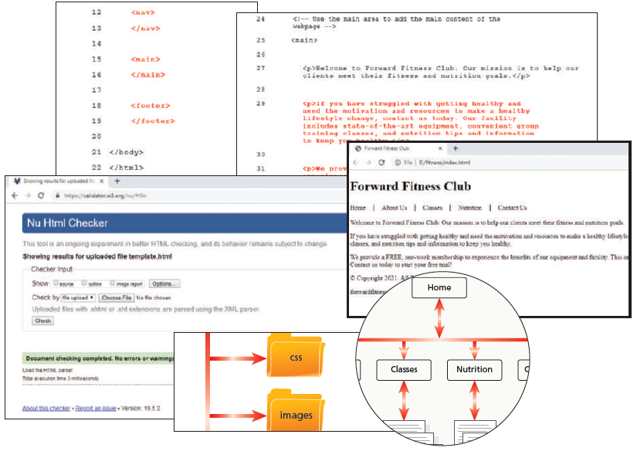
Objectives

Slide 3
Objectives
You will have mastered the material in this chapter when you can:
Explain how to manage website files
Describe and use HTML 5 semantic elements
Determine the elements to use when setting the structure of a webpage
Design and build a semantic wireframe
Create a webpage template
Insert comments in an HTML document
Add static content to a webpage template
Insert symbol codes and other character entities
Describe and use heading elements
Describe the benefits of validating web documents
Validate an HTML template
Create a home page from an HTML template
Add unique content to a webpage

Slide 4
Introduction
Building a website from scratch involves a lot of time and planning, which is one reason that professional web design services are in high demand. Some web designers have their own business and provide their services on contract to clients, who are people or other businesses that want to build or redesign a website. Other web designers work in larger organizations and provide their services to people within the organization, who are called stakeholders. As an introduction to basic website design and development, this book provides a foundation on which to build your web design skills.
As discussed in Chapter 1, before you start building a website, you must plan it, which includes meeting with the clients or stakeholders to discover their needs, the purpose of the website, and their target audience. After developing a plan, you can start constructing the website by creating an HTML document and then adding the required basic HTML elements so visitors can display the webpage in a browser. Next, include HTML 5 elements to define the specific sections or areas of the webpage. This initial HTML document can serve as the template for the site. A template is a predefined webpage that contains a specific HTML structure to be used by all pages within the website. This chapter focuses on how to build a webpage template with HTML 5 elements and then use that template to create a home page.

Slide 5
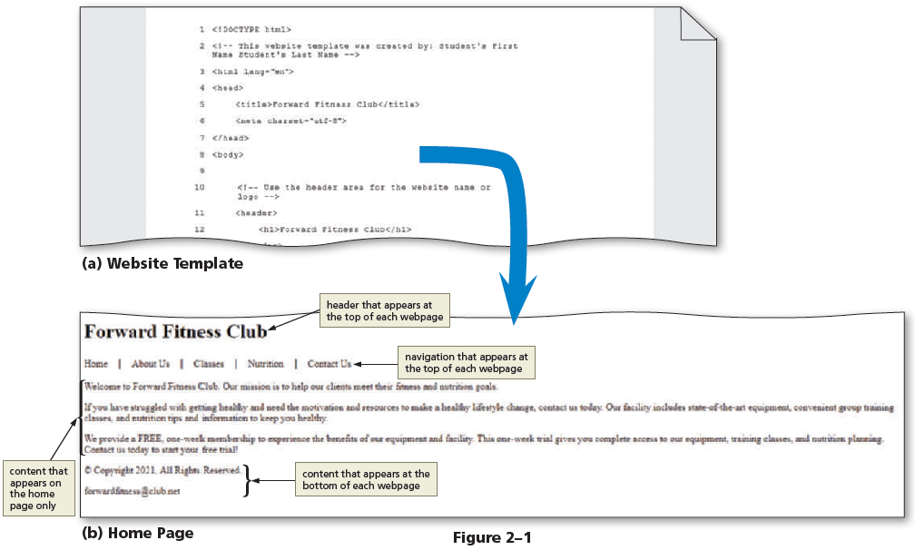
Project — Plan and Build a Website
website to help promote its business. The business owner wants the website to showcase the club’s equipment, group fitness classes, nutrition information, and contact information. The owner hired you to plan and design the Forward Fitness Club website.
The project in this chapter follows generally accepted guidelines for planning and building the webpage template shown in Figure 2–1a to produce the home page shown in Figure 2–1b. The template contains code and text including the document title, header, navigation area, and footer, which is repeated on each page of the Forward Fitness Club website. The template also includes comments to remind the web designer about the purpose of each section.

Slide 6
Roadmap
In this chapter, you will learn how to create the webpage shown in Figure 2–1. The following roadmap identifies general activities you will perform as you progress through this chapter:
create website folders to organize files.
create a template.
enter html 5 semantic elements in the document.
add comments and content to the document.
validate the document.
create and view the home page.

Slide 7
Designing a Website
Before you begin creating webpages for a website, you must have a solid web design
plan. Designing a website includes planning, articulating the website’s purpose,
identifying the target audience, creating a site map and wireframe, selecting graphics
and colors to use in the site, and determining whether to design for an optimal viewing
experience across a range of devices. Completing these activities helps ensure an
effective design for your website.

Slide 8
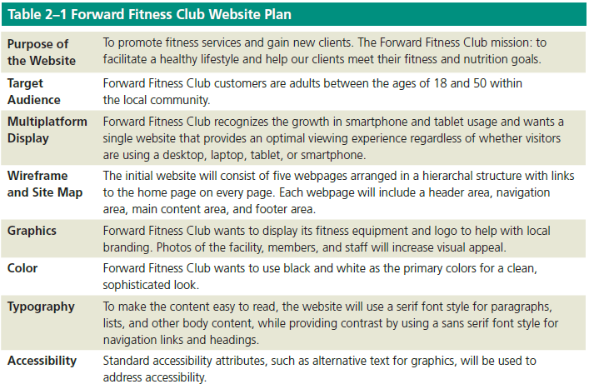
Designing a Website
After Forward Fitness Club contacted you to develop its website, you scheduled time to meet with the owner and asked several questions to plan and design the website. During the meeting, you learned the needs of the business and website, as outlined in Table 2–1.

Slide 9
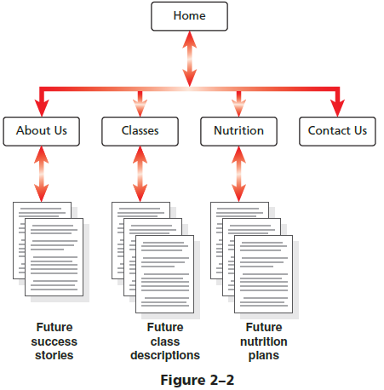
The footer Tag
Recall that a site map indicates how the pages in a website relate to each other. To create a site map, you first need to know how many pages to include in the website. The owner of Forward Fitness Club has many ideas for the website, including some ambitious ones. To keep the website simple for now while allowing room for growth, you and the owner agree that the initial website will have a total of five webpages titled Home, About Us, Classes, Nutrition, and Contact Us. Because each page will contain links to all pages and accommodate future growth, the website will use a modified hierarchal structure. The webpages will include the following content:
Home page: Introduces the fitness center and its mission statement
About Us page: Showcases the facility’s equipment and services
Classes page: Includes a schedule of available group training and fitness classes
Nutrition page: Provides nutrition tips and simple meal plans
Contact Us page: Provides a phone number, email address, physical address, and form for potential clients to request additional information about the fitness center’s services.
Figure 2–2 depicts the site map for the Forward Fitness Club website.

Slide 10
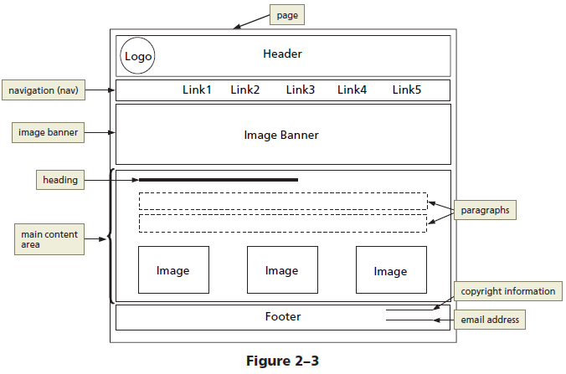
Wireframe
In addition to the site map for the Forward Fitness Club website, you have sketched out a webpage wireframe. Recall that a wireframe depicts the layout of a webpage, including its major content areas. Forward Fitness Club wants to promote its brand by including its logo, so each page will contain a designated area called the header for the logo. The header is located at the top of a webpage and identifies the site, often by displaying the business name or logo. For easy navigation, each page also will have a horizontal list of links to the other pages in the site. These page links will appear below the header in the navigation area. An image banner below the navigation area will display a fitness image. The primary page content, or the main content area, will follow the image banner and will contain information that applies to the page, including headings, paragraphs of text, and images. Lastly, the footer will be located below the primary page content and will contain copyright and contact information.
Figure 2–3 shows the proposed wireframe with these major content areas.

Slide 11
Wireframe
Recall from Chapter 1 that a semantic element provides meaning about the content of the element. For example, you use the nav element to define the navigation area. It is a semantic element because its name reflects the purpose of its content, which is to display links to other pages so visitors can navigate the website.
Semantic elements reinforce the meaning of the information provided on the webpage. A semantic wireframe uses semantic elements to define the structure of a webpage. The wireframe shown in Figure 2–3 uses four semantic elements to define the structure of the Forward Fitness Club webpages: header, nav, main, and footer.

Slide 12
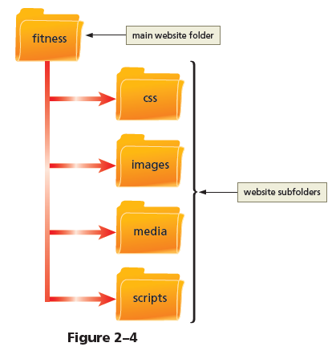
File Management
Websites use several types of files, including HTML files, image files, media such as audio and video files, and CSS files, which you learn about in Chapter 4.
Even a simple website might use hundreds of files. Therefore, each site must follow a systematic method to organize its files. Before you begin to create your first HTML page, start by creating a folder and subfolders to contain and organize your website files as shown in Figure 2–4.

Slide 13
File Management
The main folder (also called the root folder) for the Forward Fitness Club website is the fitness folder. It contains all of the files and other folders for the website.
The css folder will contain CSS files, which you create in Chapter 4 to format a webpage and its elements. The images folder will contain the Forward Fitness Club logo, photos, and other images to display on the webpages. The media folder will contain audio and video files, which you add in Chapter 9. The scripts folder will contain files related to JavaScript, which you add in Chapter 10.

Slide 14
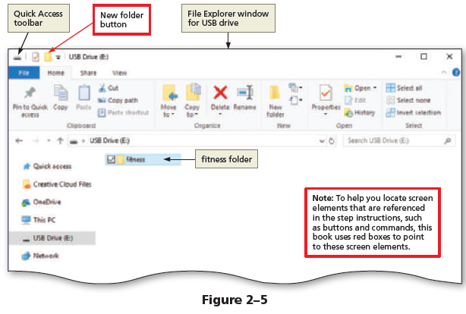
To Create a Website Folder and Subfolders
The following steps, which assume Windows 10 is running, create a folder and subfolders for the fitness website. Why? Before you can create a website, you should create a folder for the website files. You may need to ask your instructor whether you should create the website folder on a portable storage device, such as a USB flash drive.
Tap or click the File Explorer app button on the taskbar to display the File Explorer window.
Navigate to the desired location for the website folder, such as the Documents folder or your USB flash drive, to prepare to create a new folder.
Tap or click the New folder button on the Quick Access toolbar to create a new folder.
Type fitness and then press the enter key to name the folder (Figure 2–5).

Slide 15
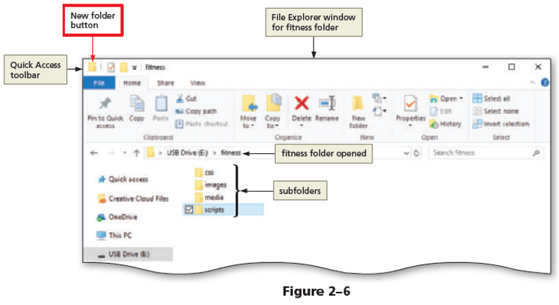
To Create a Website Folder and Subfolders
Double-tap or doubleclick the fitness folder to open it.
Tap or click the New folder button on the Quick Access toolbar to create a new folder.
Name the new folder css.
Tap or click the New folder button on the Quick Access toolbar to create a new folder.
Name the new folder images.
Tap or click the New folder button on the Quick Access toolbar to create a new folder.
Name the new folder media.
Tap or click the New folder button on the Quick Access toolbar to create a new folder.
Name the new folder scripts (Figure 2–6).

Slide 16
Using HTML 5 Semantic Elements
As you learned in Chapter 1, you begin a new HTML document by adding the basic required HTML elements to it, such as the DOCTYPE, html, head, and body elements. Within the body element, you next add HTML elements that define the structure of the page. HTML 4.01 introduced the div element (with the <div> and </div> tags) to divide a page into separate sections. Each div element usually has a unique id attribute to distinguish it from other div elements on the page.
For example, you might use a div element with an id attribute named header for the header area and another div element with an id attribute named nav for the navigation area. However, webpage authors can use any name they like to define a div id attribute, leading to inconsistency among naming conventions for websites. You will learn more about the div element in Chapter 3.

Slide 17
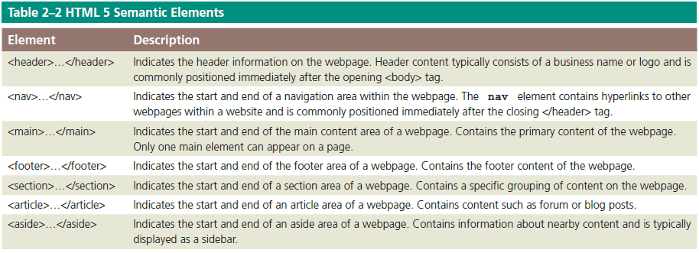
Using HTML 5 Semantic Elements
HTML 5 has transformed and improved website development with the introduction of several new semantic elements with standardized names. Table 2–2 provides a list of common HTML 5 semantic elements. The name of each tag reflects the purpose of the element. For instance, you use the footer element to display content at the bottom (or footer) of the webpage. You use the nav element to identify the navigation area of a webpage. Because many of the semantic elements help to structure the layout of the page, they are also called structural elements or layout elements.

Slide 18
Using HTML 5 Semantic Elements
Professional web designers debate whether to use the div element or the main element to define the main content area of a webpage. Those who favor the div element argue that it has widespread browser support. The W3C introduced the main element after other semantic elements, and not all browsers or text editors recognize it yet.
Web designers who favor the main element do so because main is a semantic element while div is not. In other words, the name of the main element describes its purpose and function. The div element relies on its id attribute to provide meaning.
After discussing the pros and cons of the main and div elements with the owner of the Forward Fitness Club, you decide to use the main element for the fitness website. Because it is a new site that does not have to incorporate webpages created with earlier versions of HTML, it will use the new HTML 5 semantic elements, including header, nav, main, and footer, to lay out the webpages. Although the div element achieves the same results in layout, the future of web development includes using the new HTML 5 layout tags, and Forward Fitness wants to create a foundation for this future. Using the semantic HTML 5 elements standardizes naming conventions, making webpages more universal, accessible, and meaningful to search engines.

Slide 19
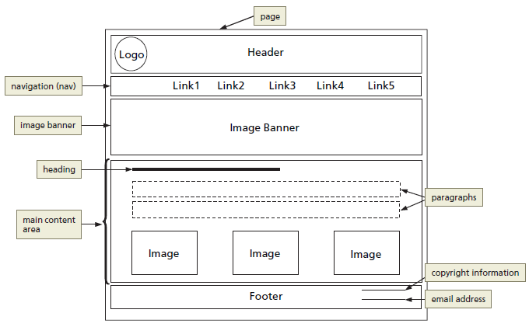
Header Element
The header element structurally defines the header area of a webpage.
The header element starts with a <header> tag and ends with a </header> tag. Content placed between these tags appears on the webpage as part of the header element. Web designers often place a business name or logo within the header element.

Slide 20
Nav Element
The nav element structurally defines the navigation area of a webpage. The nav element starts with a <nav> tag and ends with a </nav> tag. The nav element usually includes links to other pages within the website.

Slide 21
Main Element
The main element structurally defines the main content area of a webpage. The main element starts with a <main> tag and ends with a </main> tag. Each page can have only one main element because its content should be unique to each page.
At the time this book was written, all current major browsers supported the main element, with the exception of Internet Explorer 11 and earlier versions. While Internet Explorer 11 will display content within the main element, it does not fully support the element. For example, Internet Explorer 11 might not correctly display formatting applied to the main element.

Slide 22
Footer Element
The footer element structurally defines the bottom, or footer area, of a webpage. The footer element starts with a <footer> tag and ends with a </footer> tag.
Common content found within a webpage footer includes copyright information, contact information, social media links, and policy links.

Slide 23
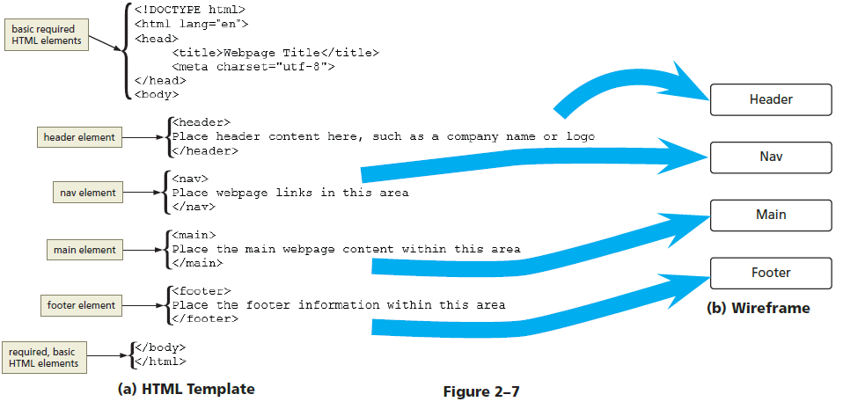
Webpage Template
Figure 2–7 identifies the relationship between a coded webpage template with header, nav, main, and footer elements and the conceptual wireframe design of a webpage.

Slide 24
Creating a Webpage Template
A hallmark of a well-designed website is that its webpages have the same look and feel. In other words, most pages have the same layout and all the pages share the same color scheme, typography, and style of graphics. In addition, elements work the same way on each page. For example, the navigation bar appears in the same position on each page and uses the same colors, fonts, and font styles. Visitors select a link on the navigation bar the same way, such as by tapping or clicking a page name. The selected link then appears in a contrasting color.
To make sure the webpages in a site share a standard layout, you can create a template, an HTML document that contains elements that should appear on each page. Instead of creating a webpage from scratch, open the template document in a text editor and save it using the name of the new webpage. You can then concentrate on adding content for that particular page rather than re-creating the basic required HTML elements and the structural elements.
For the fitness website, you will create a template that includes the basic required HTML elements (the DOCTYPE declaration and the html, head, title, meta, and body elements) and the four HTML structural, semantic elements identified in the webpage wireframe shown in Figure 2–3: header, nav, main, and footer.

Slide 25
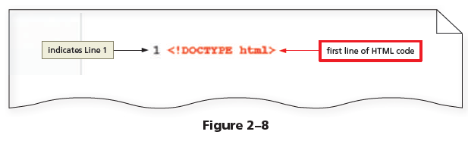
To Create a Webpage Template Document
To create a webpage template, you create an HTML document with the HTML elements that define the webpage structure. Use your preferred text editor to create the template or ask your instructor which text editor to use. The following steps create a basic webpage template.
Open your text editor, tap or click File on the menu bar, and then tap or click New if you need to open a new blank document.
Tap or click File on the menu bar and then tap or click Save As to display the Save As dialog box.

Slide 26
To Create a Webpage Template Document
Navigate to your fitness folder and then double-tap or double-click it to open it.
In the File name box, type template to name the file.
Tap or click the Save as type button and then tap or click Hyper Text Markup Language to select the file format.
Tap or click the Save button to save the template in the fitness folder.
On Line 1 of the text editor, type <!DOCTYPE html> to define a new HTML 5 document (Figure 2–8).

Slide 27
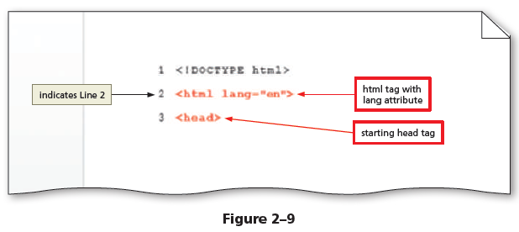
To Create a Webpage Template Document
Press the enter key to add Line 2 and then type <html lang="en"> to add a starting <html> tag that defines the language as English.
Press the enter key to add Line 3 and then type <head> to add a starting <head> tag (Figure 2–9).

Slide 28
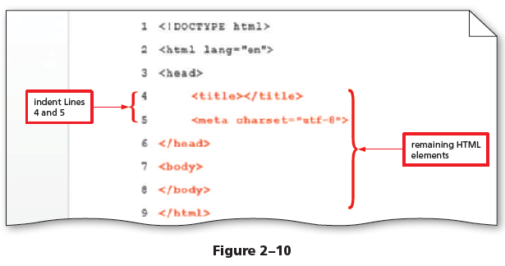
To Create a Webpage Template Document
Add the following HTML elements, also shown in bold and red in Figure 2–10, to complete the template, using the spacebar or tab key to indent Lines 4 and 5 and using the shift+tab keys to stop indenting.
<title></title>
<meta charset="utf-8">
</head>
<body>
</body>
</html>
2
Save your changes.

Slide 29
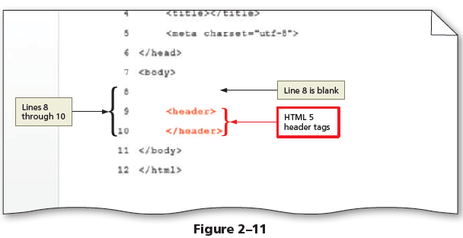
To Add HTML 5 Semantic Elements to a Webpage Template
The wireframe in Figure 2–3 defines four areas to display content for the website. To define these content areas, insert the following HTML 5 elements between the <body> and </body> tags: <header> </header>, <nav> </nav>, <main> </main>, and <footer> </footer>. Recall that the HTML 5 header element defines the header area of the webpage. The nav element defines the navigation area of the webpage. The main element defines the primary content area of the webpage. The footer element defines the footer area of the webpage. The following steps insert HTML 5 structural elements within the body tags.
1
Place your insertion point after the beginning <body> tag and press the enter key twice to insert new Lines 8 and 9.
On Line 9, press the tab key and then type <header> to add a starting header tag.
Press the enter key to insert a new Line 10 and then type </header> to add an ending header tag (Figure 2–11).

Slide 30
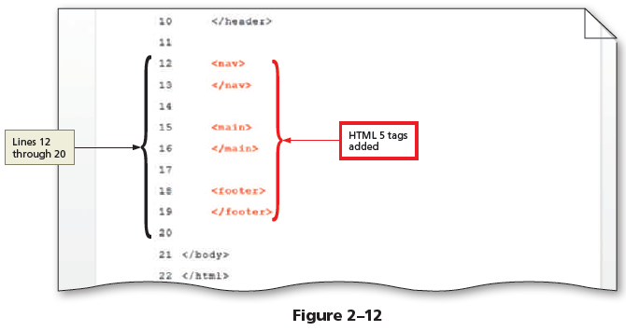
To Add HTML 5 Semantic Elements to a Webpage Template
Add the following HTML 5 tags, also shown in bold and red in Figure 2–12, to complete the wireframe, indenting each line and inserting a blank line after each ending tag.
<nav>
</nav>
(blank line)
<main>
</main>
(blank line)
<footer>
</footer>
3
Save your changes.

Slide 31
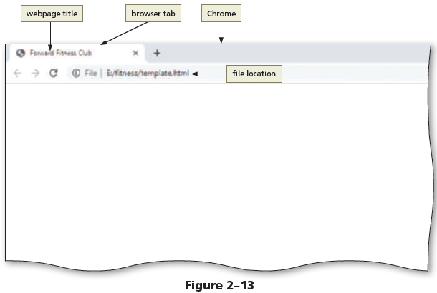
To Add a Title to a Webpage Template
Recall that when a webpage is displayed in a browser, the browser tab displays the document title. To add a document title, type the title text between the starting and ending title tags. The following step adds a webpage title to a template.
Place your insertion point after the beginning <title> tag and type Forward Fitness Club to add a webpage title.
Save your changes and then view the page in a browser to display the webpage title (Figure 2–13).

Slide 32
Comments
As you create a webpage template, include comments about the HTML elements you use to define the areas within the webpage. Comments can provide additional information about these areas and the type of information they include, which is especially helpful if you stop working on a partially completed page and then return to it later. Add a comment before a tag using the following syntax:
<!-- Place your comment here -->
The comment syntax uses the angle brackets, similar to the HTML tags. The next character is an exclamation mark followed by two dashes (--). Add the comment text after the first set of dashes. For example, you use comments to give instructions on how to use the template or to identify the author of the website. Close the comment by adding two dashes, followed by a closing angle bracket. One comment can extend over multiple lines, as shown in the following example:
<!-- Student Name
File Name
Date
-->
If you are using Notepad++, the text you enter scrolls continuously to the right unless you turn on the word wrap feature. Word wrap causes text lines to break at the right edge of the window and appear on a new line, so all entered text is visible in the Notepad++ window. When word wrap is enabled, a paragraph of text is assigned a single logical line number even though it may appear to be displayed on multiple physical lines in Notepad++. Word wrap does not affect the way text prints.

Slide 33
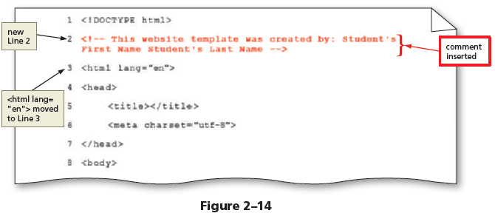
To Add Comments to a Webpage Template
When you create a webpage template, including comments provides additional information about how to use the sections of the webpage. You can also use a comment to identify that you are the author of the webpage. Why? When creating a new webpage from a template, comments provide insight on the type of information to include. The following steps add comments to a webpage template.
Place the insertion point after the <!DOCTYPE html> tag and then press the enter key to insert a new Line 2.
Type <!-- This website template was created by: Student’s First Name Student’s Last Name --> on Line 2 to add a comment at the beginning of the document that identifies the author (Figure 2–14).

Slide 34
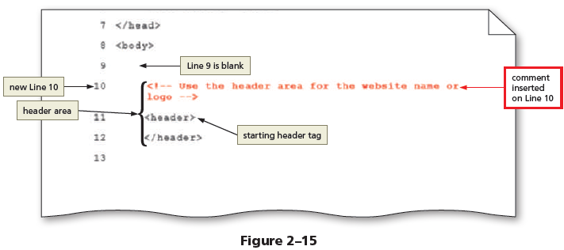
To Add Comments to a Webpage Template
Place the insertion point on the blank Line 9 and press the enter key to insert a new Line 10.
On Line 10, press the tab key and then type <!-- Use the header area for the website name or logo --> to add a comment identifying the type of information to include in the header area (Figure 2–15).

Slide 35
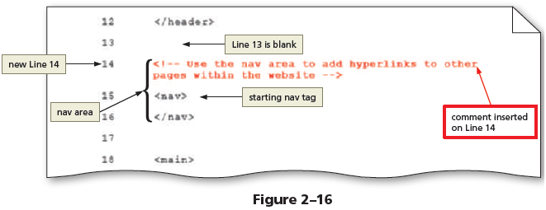
To Add Comments to a Webpage Template
Place the insertion point on the blank Line 13 and press the enter key to insert a new Line 14.
On Line 14, type <!-- Use the nav area to add hyperlinks to other pages within the website --> to add a comment above the navigation area (Figure 2–16).

Slide 36
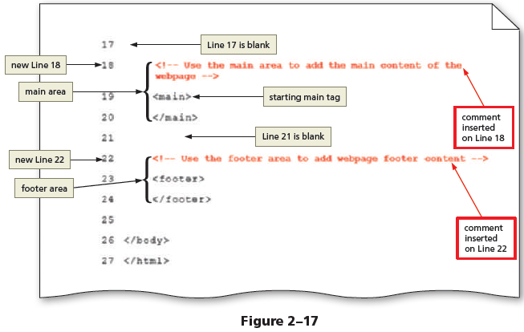
To Add Comments to a Webpage Template
Place the insertion point on the blank Line 17 and press the enter key to insert a new Line 18.
On Line 18, type <!-- Use the main area to add the main content of the webpage --> to add a comment above the main area.
Place the insertion point on the blank Line 21 and press the enter key to insert a new Line 22.
On Line 22, type <!-- Use the footer area to add webpage footer content --> to add a comment above the footer area (Figure 2–17).
Save your changes.

Slide 37
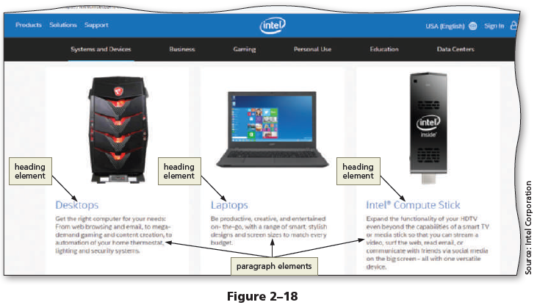
Heading Elements
You use heading elements to provide a title or heading before a paragraph of text or section of a page. Headings indicate that a new topic is starting and typically identify or summarize the topic. On a webpage, headings appear in a larger font size than normal text, making it easy for users to quickly scan the page and identify its sections. Figure 2–18 shows examples of heading elements on Intel’s website. The text in blue, Desktops, Laptops, and Intel« Compute Stick, are all examples of heading elements.

Slide 38
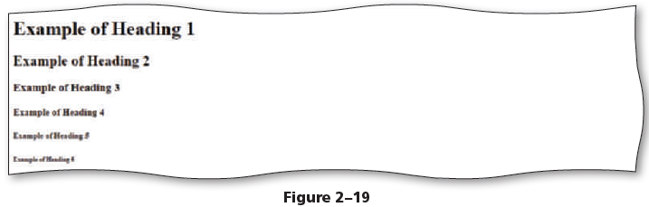
Heading Elements
Heading sizes, or levels, run from 1 (the largest) to 6 (the smallest). Heading level 1 is designed to mark major headings, while heading levels 2 to 6 are for subheadings. The start tag for heading level 1 is <h1> and the end tag is </h1>. The start tag for heading level 2 is <h2>, the end tag is </h2>, and so on. Figure 2–19 displays the size differences among heading levels 1 through 6. In the upcoming steps, you insert a heading element with the header element on the template file for the fitness website.

Slide 39
Webpage Content
After inserting the HTML tags and comments for a webpage template, add static content or content that will appear on every webpage, such as the business name or logo, the webpage links, and the footer information. Content is the text or other item that is displayed in a browser. Place content between the starting and ending tags. Following is an example of content added between header tags:
<header>
<h1>Forward Fitness Club</h1>
</header>
For the Forward Fitness Club website, the header area contains the business name, which will appear at the top of every page. Other tags that contain static content include the nav area, which contains links to all pages within the website and will remain the same on each page. In addition, the footer area, which contains the copyright notice and an email address, will remain the same throughout the website.
Adding static content to a template saves time. Remember that the template will be used to create the webpages for the website. Because this content is meant to be displayed on each page, add it to the template once rather than to each page many times.

Slide 40
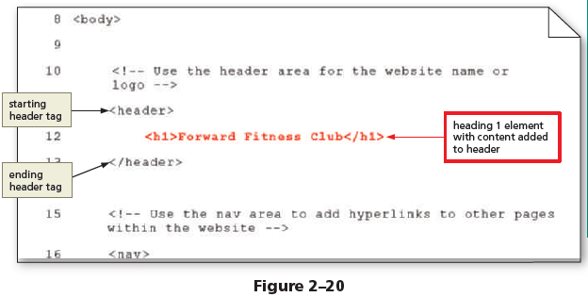
To Add Content to the Header Section
Now that the webpage template structure is complete, you can add static content that will appear on each webpage within the website. The header of each webpage in the fitness website should display the name of the business, Forward Fitness Club. For now, you enter the business name as text. In Chapter 3, you insert an image that displays the business logo, including a graphic and the business name. The following step adds content to the header area of a webpage template. HTML Ch
apter 2
Place the insertion point after the beginning <header> tag and press the enter key to insert a new Line 12.
On Line 12, press the tab key and then type <h1>Forward Fitness Club</h1> to add the business name to the webpage template (Figure 2–20).

Slide 41
Using Symbol Entities
When adding content to a webpage, you often need to insert symbols or characters, such as a copyright symbol, ⌐. Some symbols such as less than (<) or greater than (>) are reserved for other uses, such as signifying the start and end of HTML tags. Other symbols such as ⌐ or € are not included on standard keyboards. Rather than inserting reserved symbols directly or avoiding other special symbols, you can insert a symbol on an HTML webpage by typing its HTML entity name or entity number. Inserting an HTML character entity in the code displays a reserved HTML character on the webpage. All character entities start with an ampersand (&) and end with a semicolon (;) to signal to the browser that everything in between is an entity representing a symbol. An entity name is an abbreviated name, and an entity number is a combination of the pound sign (#) and a numeric code. For example, the entity name for the copyright symbol is &copy; and the entity number for the copyright symbol is &#169;. You can use either an entity’s name or number in your HTML code.
An entity name is easier to remember than an entity number, though more browsers support entity numbers than names.

Slide 42
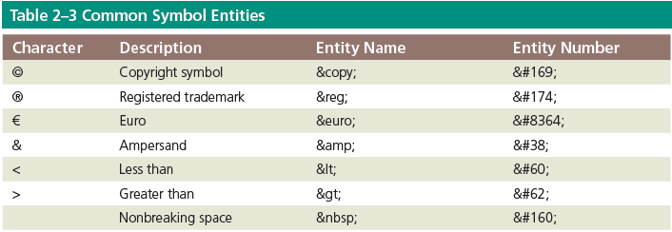
Using Symbol Entities
Table 2–3 lists common symbols along with their entity names and numbers.

Slide 43
Using Symbol Entities
A commonly used character is a nonbreaking space &nbsp;, which forces browsers to display a blank space. You can insert indents, extra spaces, and paragraph breaks to make HTML code easier to read and maintain. When a browser displays the webpage, however, it ignores this extra white space, treating multiple spaces, indents, and paragraph breaks as a single space. For example, when you press the tab key or use the spacebar to indent header tags and content in the HTML code, a browser displays the header content on the left margin of the webpage with no indent.
Likewise, if you insert two spaces between the page names in the nav area, a browser removes the extra spaces when it displays the webpage so only one space appears between the page names. What can you do if you want to display the extra spaces in a browser? You use the nonbreaking space character entity as in the following code:
<p>Home &nbsp; &nbsp; About Us</p>

Slide 44
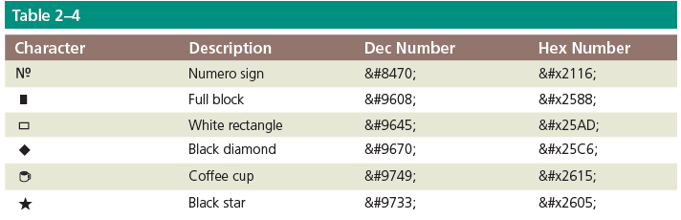
Using Symbol Entities
Some characters only use decimal or hexadecimal entity numbers. These number codes are known as dec and hex for short. To use a dec character code, begin with an ampersand (&), followed by a number sign (#), followed by the dec number, and then end with a semicolon (;). For example, to insert a black square, you use the decimal code &#9632;. If you want to use a dec entity number to display a black square between navigation links, use the following code:
Home &nbsp; &#25A0; &nbsp; About us
To use a hex character code, begin with an ampersand (&), followed by a number sign (#), followed by a lowercase letter “x”, followed by the hex number, and then end with a semicolon (;). For example, to insert a black square using a hex entity number, use &#x25A0;.
Today, there are hundreds of HTML character symbols, ranging from currency and math operators, to emojis. Table 2–4 lists some characters and their dec and hex numbers.

Slide 45
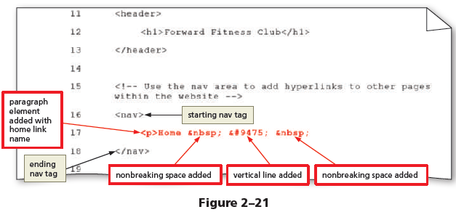
To Add Text and Nonbreaking Spaces to the Nav Section
Next, between the beginning and ending nav tags, add a paragraph element with the name of the links to the other pages. Why? The nav area is designed to contain hyperlinks to other pages within the website. To insert two spaces between each page name, use the nonbreaking space character entity &nbsp;. The following steps add content to the nav area of a webpage template.
Place the insertion point after the beginning <nav> tag and press the enter key to insert a new Line 17.
On Line 17, press the tab key and then type <p>Home to add the first webpage link name.
Press the spacebar once and then type &nbsp; &#9475; &nbsp; to add a nonbreaking space, a vertical line, and another nonbreaking space (Figure 2–21).

Slide 46
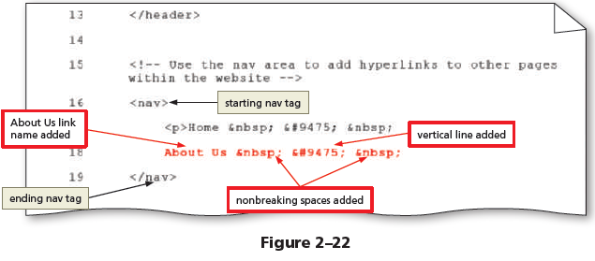
To Add Text and Nonbreaking Spaces to the Nav Section
Press the enter key to insert a new Line 18.
On Line 18, type About Us to add the second webpage link name.
Press the spacebar once and then type &nbsp; &#9475; &nbsp; to add a nonbreaking space, a vertical line, and another nonbreaking space (Figure 2–22).

Slide 47
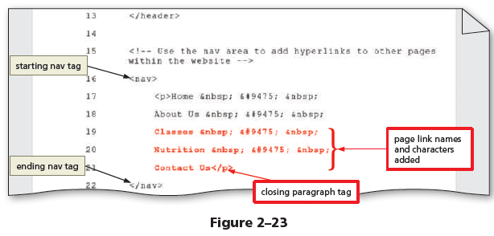
To Add Text and Nonbreaking Spaces to the Nav Section
Press the enter key to insert a new Line 19, type Classes to add the third webpage link name, press the spacebar, and then type &nbsp; &#9475; &nbsp; to add a nonbreaking space, a vertical line, and another nonbreaking space.
Press the enter key to insert a new Line 20, type Nutrition to add the fourth webpage link name, press the spacebar, and then type &nbsp; &#9475; &nbsp; to add a nonbreaking space, a vertical line, and another nonbreaking space.
Press the enter key to insert a new Line 21 and then type Contact Us</p> to add the fifth webpage link name (Figure 2–23).
Save your changes.

Slide 48
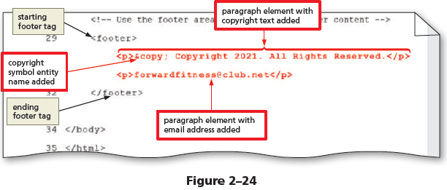
To Add Content and a Symbol to the Footer Section
The footer section of the website contains a copyright symbol and an email address. Why? Legal notices and contact information usually appear in the footer of a webpage. You add this content to the footer in the template file so that the content appears on all webpages in the website. The following steps add content to the footer area of a webpage template.
Place the insertion point after the beginning <footer> tag and press the enter key to insert a new Line 30.
On Line 30, press the tab key and then type <p>&copy; Copyright 2021. All Rights Reserved.</p> to add a paragraph element with the copyright symbol and additional copyright information.
Press the enter key to insert a new Line 31 and then type <p>forwardfitness@club.net</p> to add a paragraph element with an email address to the footer section (Figure 2–24).

Slide 49
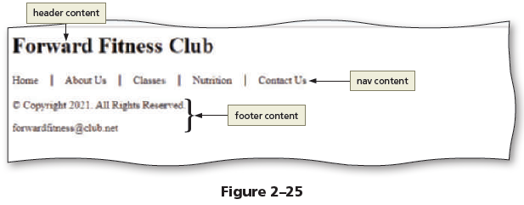
To Add Content and a Symbol to the Footer Section
Save your changes and then view the page in a browser to display the webpage template (Figure 2–25).

Slide 50
Validating HTML Documents
After creating an HTML file, you validate the document to verify the validity of the HTML code. When you validate an HTML document, you confirm that all of the code is correct and follows the established rules set by the W3C, the organization that sets the standards for HTML. The W3C recommends validating all HTML documents and making validation part of your webpage testing.
Many validation services are available on the web; you can use any of them to make sure that your HTML code follows standards and is free of errors. Some check only for errors, while others flag errors and suggest how to correct them. The W3C has a free online validator that checks for errors, indicates where they are located, and suggests corrections. Keep in mind that a validator looks for coding errors; it cannot make sure that browsers will display the webpage as you intend. To test the design of a webpage, you must display it in all of the popular browsers.
This book uses the online W3C Markup Validation Service (validator.w3.org). This validator checks the markup validity of web documents in HTML and XHTML, along with some other markup languages. The validator scans the DOCTYPE statement to see which version of HTML or XHTML you are using, and then checks to see if the code is valid for that version. You upload your HTML file to the validator, which means you transfer a copy of the document to the validation website. The validator reviews each line of code and locates any errors.
If the validator detects an error in your HTML code, it displays a warning such as “Errors found while checking this document as HTML 5!” The W3C validator displays this warning in red in the header bar. A Result line below the header bar shows the number of errors in the document. You can scroll down the page or tap or click the Jump To: Validation Output link to see detailed comments on each error.

Slide 51
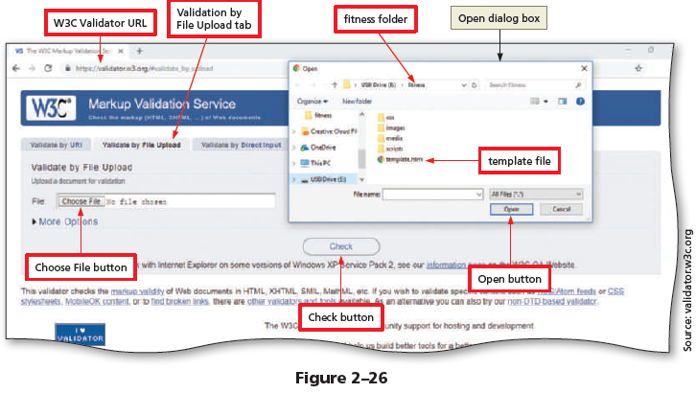
To Validate the Webpage Template
Before you use the webpage template to create the necessary webpages for the fitness website, run the template through the W3C validator to check the document for errors. Why? If the document has any errors, validating gives you a chance to identify and correct them before using the template to create a webpage. The following steps validate an HTML document.
Open your browser and type https://validator.w3.org/ in the address bar to display the W3C Markup Validation Service page.
Tap or click the Validate by File Upload tab to display the Validate by File Upload information.
Tap or click the Choose File button to display the Open dialog box.

Slide 52
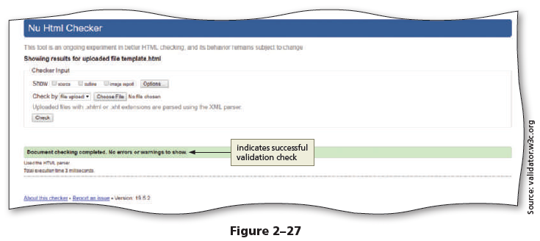
To Validate the Webpage Template
Tap or click the template.html document to select it.
Tap or click the Open button to upload the selected file to the W3C validator.
Tap or click the Check button to send the document through the validator and display the validation results page (Figure 2–27).

Slide 53
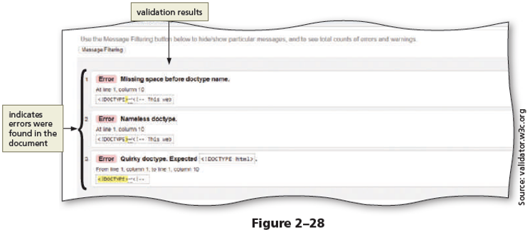
The flex Items
If the webpage template was created successfully, you should not receive any errors, but you can review what the validator provides when a document with errors is uploaded to the validator. Why? When errors are detected on a webpage, the validator provides information about the location of the error so you can identify and correct them. The following steps insert an error in the template document and then validate the document with the W3C validator.
Return to the template document in your text editor and delete html on Line 1 to remove “html” from the DOCTYPE declaration.
Save your changes and then return to the W3C Markup Validation Service page in your browser to display the W3C validator.

Slide 54
The flex Items
If necessary, tap or click the Validate by File Upload tab to display the Validate by File Upload information.
Tap or click the Choose File button to display the Open dialog box.
Navigate to the fitness folder, select the template.html file, and then tap or click the Open button to upload the file.
Tap or click the Check button to run the template file through the validator.
Scroll down to display the error messages (Figure 2–28).

Slide 55
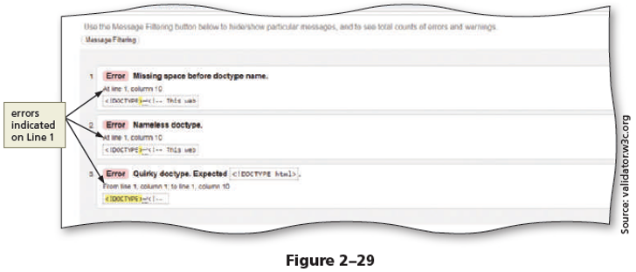
The flex Items
Scroll down to display the validation errors.
Review the errors and note the line numbers of the errors in the document (Figure 2–29).
Return to your text editor and type html after the <!DOCTYPE declaration on Line 1 to correct the error.
Save your changes and validate the document again to confirm it does not contain any errors.

Slide 56
Creating a Home Page Using a Webpage Template
After creating a template for a website, you can save time by using the template to create the webpages in the site. The advantage of starting with a template is that it includes content and HTML elements that appear on every page. By opening the template and then saving it with a new name that corresponds to a page on the site, you save time, ensure consistency across the website, and avoid having to re-create repeating elements such as navigation bars. In the new webpage document, you can focus on developing the parts that are unique to that page.
Now that you have created a template for the Forward Fitness Club website, use it to create the website home page. Recall from Chapter 1 that the home page of a website is usually named index.html. Website home pages use this name for a practical reason. If someone uses a browser to enter a URL that includes the site’s domain but does not end with a file name, the browser looks for and displays the index.html page automatically.

Slide 57
Creating a Home Page Using a Webpage Template
When you create the Forward Fitness Club home page from a template, the page includes a document title, HTML structural elements to organize the page, the business name in the header, navigation text, and a copyright notice and business email address in the footer. To complete the home page, you add three paragraphs to the main area. The first paragraph welcomes visitors to Forward Fitness Club and restates the business mission. The second paragraph describes the facility and the benefits of becoming a member. The third paragraph provides a strong call to action, which is an offer or instruction to visitors to contact the business to take advantage of a free one-week trial membership.
To create the paragraphs in the main area, you use the paragraph (<p></p>) element, as you did in the nav area. The paragraph element has the following syntax:
<p>content</p>
Everything between the <p> and </p> tags is a single paragraph. Browsers add space before and after each paragraph element to separate paragraphs. In contrast, for a line break, browsers do not add space before and after the <br> tag.

Slide 58
To Create a Home Page Using a Webpage Template and Add Content
Create the Forward Fitness Club home page by opening the webpage template and then saving the page with a new name in the root fitness folder. Why? Using a template saves time in coding because the basic wireframe for the page is already established in the template. As a document for one of the main pages of the site, the home page belongs in the root folder. You use the fitness template to create all the webpages for the website. The following steps create the home page for the fitness website using the webpage template.
Tap or click File on the menu bar and then tap or click Save As to display the Save As dialog box.
In the File name text box, type index to name the file.
Tap or click the Save button to save the index file in the fitness folder.

Slide 59
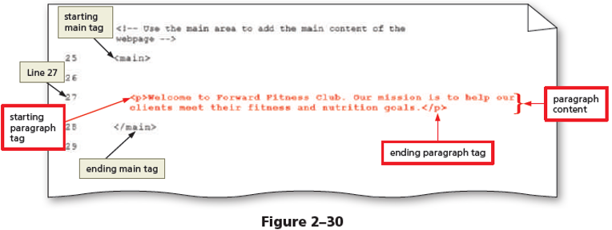
To Create a Home Page Using a Webpage Template and Add Content
Place your insertion point after the beginning <main> tag and press the enter key twice to insert two new lines, in this case, Lines 26 and 27.
On Line 27, press the tab key and then type <p>Welcome to Forward Fitness Club. Our mission is to help our clients meet their fitness and nutrition goals.</p> to add paragraph tags and content to the page (Figure 2–30).

Slide 60
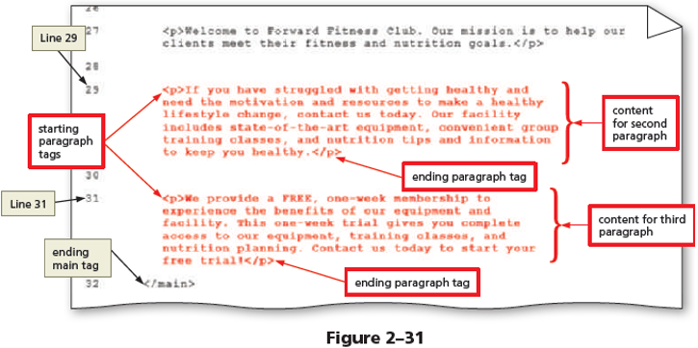
To Create a Home Page Using a Webpage Template and Add Content
Press the enter key two times to insert two new lines and then type <p>If you have struggled with getting healthy and need the motivation and resources to make a healthy lifestyle change, contact us today. Our facility includes state-of-the-art equipment, convenient group training classes, and nutrition tips and information to keep you healthy.</p> on Line 29 to add a second paragraph to the page.

Slide 61
To Create a Home Page Using a Webpage Template and Add Content
Press the enter key two times to insert two new lines and then type <p>We provide a FREE one-week membership so you can experience the benefits of our equipment and facility. This one-week trial gives you complete access to our equipment, training classes, and nutrition planning. Contact us today to start your free trial!</p> on Line 31 to add a third paragraph to the page (Figure 2–31).
Press the enter key to insert a new blank line above the ending </main> tag.
Check the spelling of your document and save your changes.

Slide 62
To Display a Home Page in the Default Browser
After creating the home page or any other page of the website and adding content to it, display it in a browser to view the completed page. Why? You should view every page you create in a browser. Besides using a command in an HTML editor, such as the Launch in Chrome command on the Run menu in Notepad++, you can open an HTML file from a file viewer such as File Explorer or Finder. When you double-tap or doubleclick an HTML file, it opens in the default browser on your computer. If you want to open the file in a different browser, you can press and hold or right-click the HTML file, tap or click Open with, and then tap or click an alternate browser. The following steps display the Forward Fitness Club home page in the default browser.

Slide 63
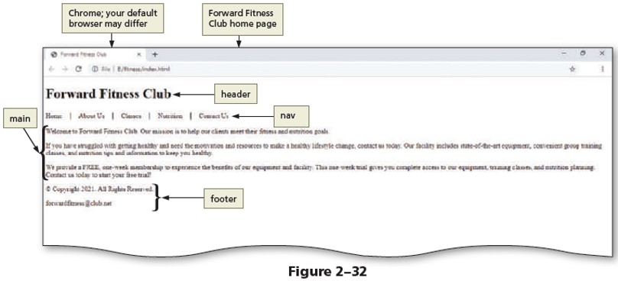
To Display a Home Page in the Default Browser
Run File Explorer and navigate to the fitness folder to display the index .html page.
Double-tap or double-click the index.html file to display the page in the default browser on your computer (Figure 2–32).

Slide 64
To Display a Home Page in the Default Browser
If spelling errors appear in the page, run the spelling checker or edit the text in your HTML text editor and then save your changes.
Refresh the browser by tapping or clicking the Refresh button on the address bar.
Close the browser.
Exit the HTML text editor.

Slide 65
Chapter Summary
In this chapter, you learned how to prepare a website by
organizing folders for the webpage files, using HTML 5
structural elements to create a webpage template, validating
the template, and then creating the home page. The items
listed below include all the new concepts and skills you have
learned in this chapter, with the tasks grouped by activity.

Slide 66
Chapter Summary
Designing a Website
Examine the Site Map
Review the Wireframe
Create a Website Folder and Subfolders
Using HTML 5 Semantic Elements
Use the Header Element
Include the Nav Element
Use the Main Element
Insert the Footer Element
Creating a Webpage Template
Create a Webpage Template Document
Add HTML 5 Semantic Elements to a Webpage Template
Add Comments to a Webpage Template
Add Content to the Header Section
Using Symbol Entities
Add Text and Nonbreaking Spaces to the Nav Section
Add Content and a Symbol to the Footer Section
Validating HTML Documents
Validate the Webpage Template
Validate an HTML Document with Errors
Creating a Home Page
Create a Home Page Using a Webpage Template and Add Content
Display a Home Page in the Default Browser

